Slide 1
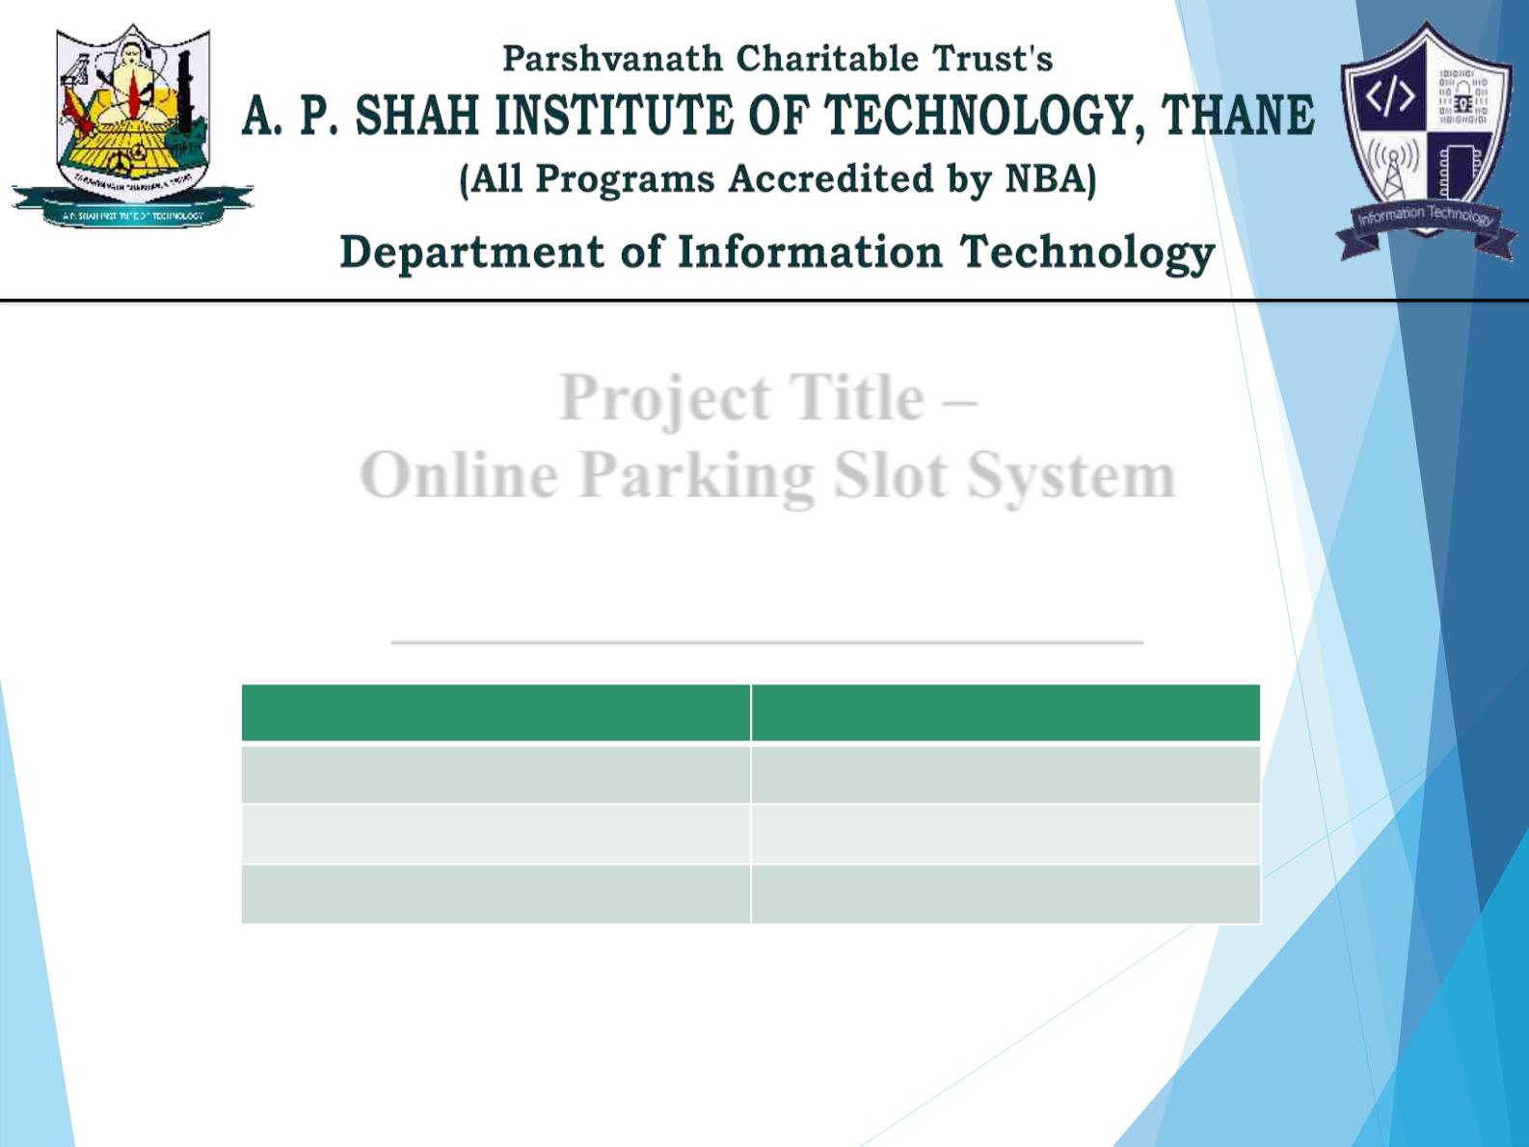
Project Title –
Online Parking Slot System
GGrroouupp mmeemmbbeerrss wwiitthh SSttuuddeenntt IIdd
GROUP MEMBERS NAME
DIVYAL CHHEDA
PRATIK PANDIT
MOODLE ID
21204005
21204009
21204002
BHAVIKA BAND
Project Guide - Prof. Apeksha Mohite

Slide 2

Contents
●
●
●
●
●
●
●
Introduction
Objectives
Scope
Features / Functionality
Project Outcomes
Technology Stack
Block Diagram

Slide 3

1. Introduction
ØIn today’s busy world , some people are unable to get parking
of the particular vehicle.
ØNow-a-days, because of more vehicles, they can search for
Parking slot available easily.
ØThe idea of Online Parking Slot System is innovative and
useful for the people who are worried to park their vehicles.

Slide 4

2. Objectives
Ø To handle the entire activity of parking slot admin.
Ø To keep track of all the information about the vehicles parked
services provided.
Ø To contain database where all the information will be stored safely.

Slide 5

3. Scope
Ø This project will keep track of all the vehicles parked and
modifying/removing services information.
Ø The system will be able to handle all the necessary information.
Ø It is easy to understand.
Ø It is easy to operate.
Ø It generates vacant Parking slots.

Slide 6

4. Feature /Functionality
1: Vehicles Categorization.
2: User-friendly interface
3: Update about Vacant spaces for parking.
4: Displays parked vehicles or slot if full or empty.
5: Easy to use.

Slide 7

5. Outcome of Project
Ø Admin will be able to login.
Ø The admin can add/delete/update the parked vehicles details.
Ø The admin can also check the vacant spaces to park other
vehicles.
Ø It can able to search for the vehicles related information.
Ø Also, Details of customer and vehicles for parking can be seen.
Ø This keeps records of all vehicles related information, vacant
spaces, non-vacant spaces, etc.

Slide 8
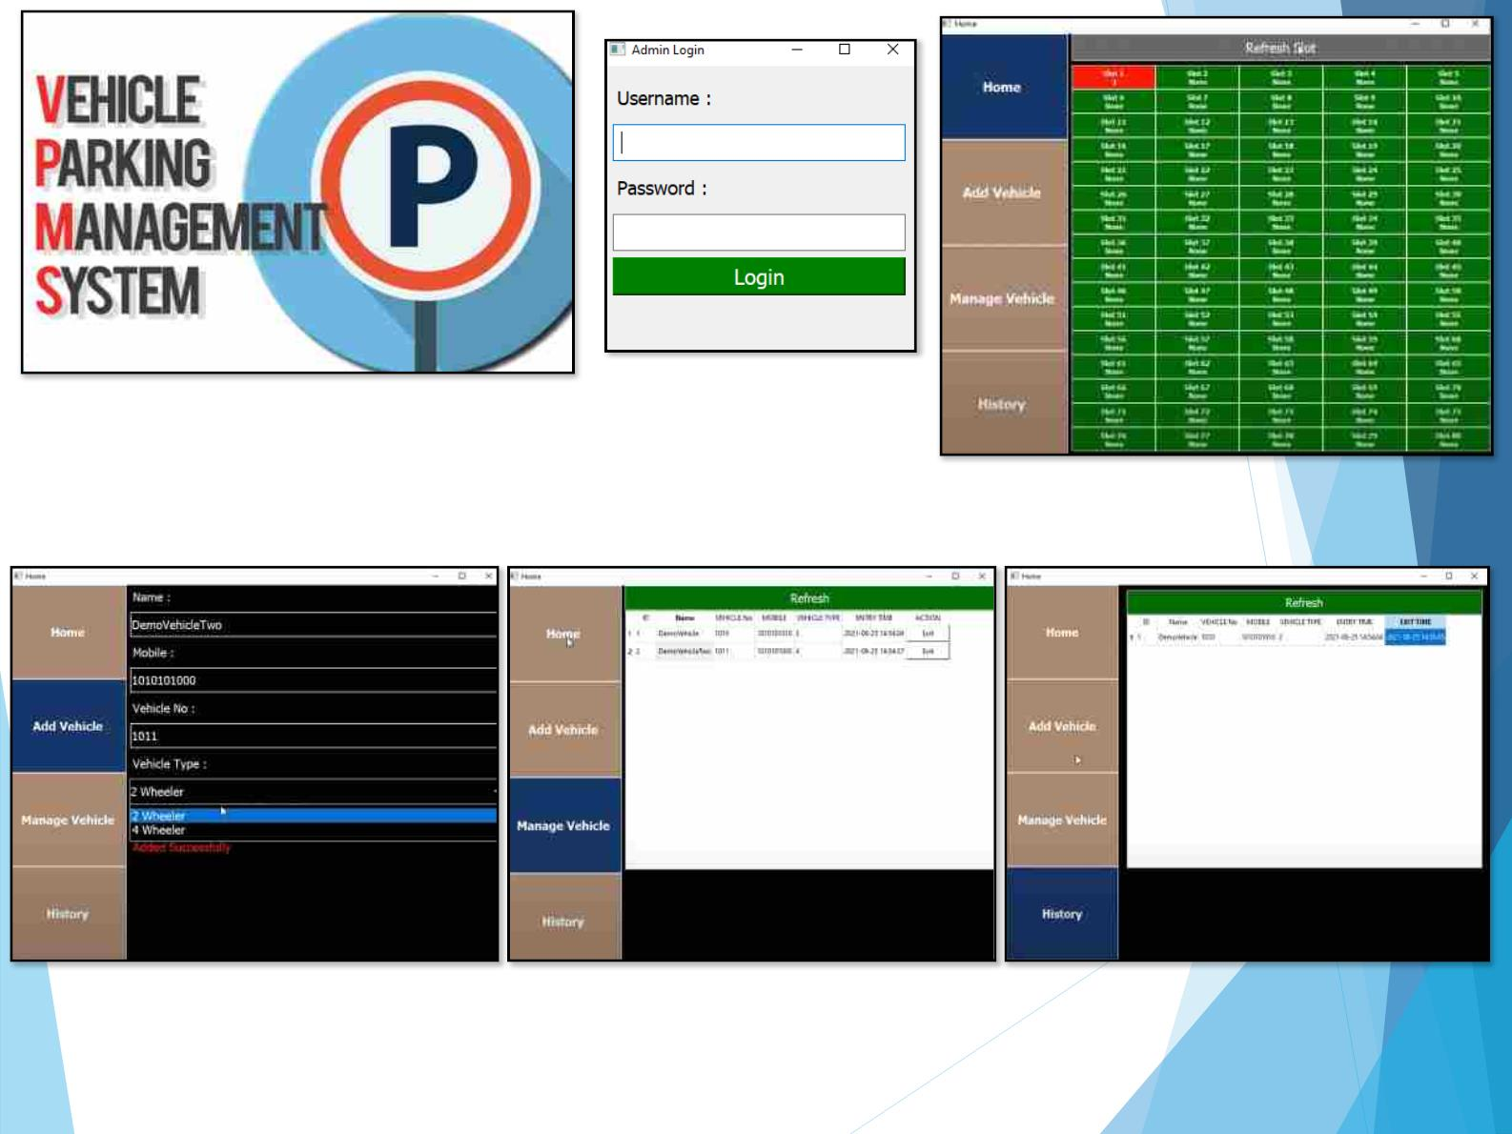

Slide 9

6. Technology Stack
Ø FRONT END – Python – 3.9
– Tkinter
Ø BACK END – db - SQLite
– Xampp, phpmyadmin
Ø Editor – VS Code
Ø Operating System – Windows 10

Slide 10
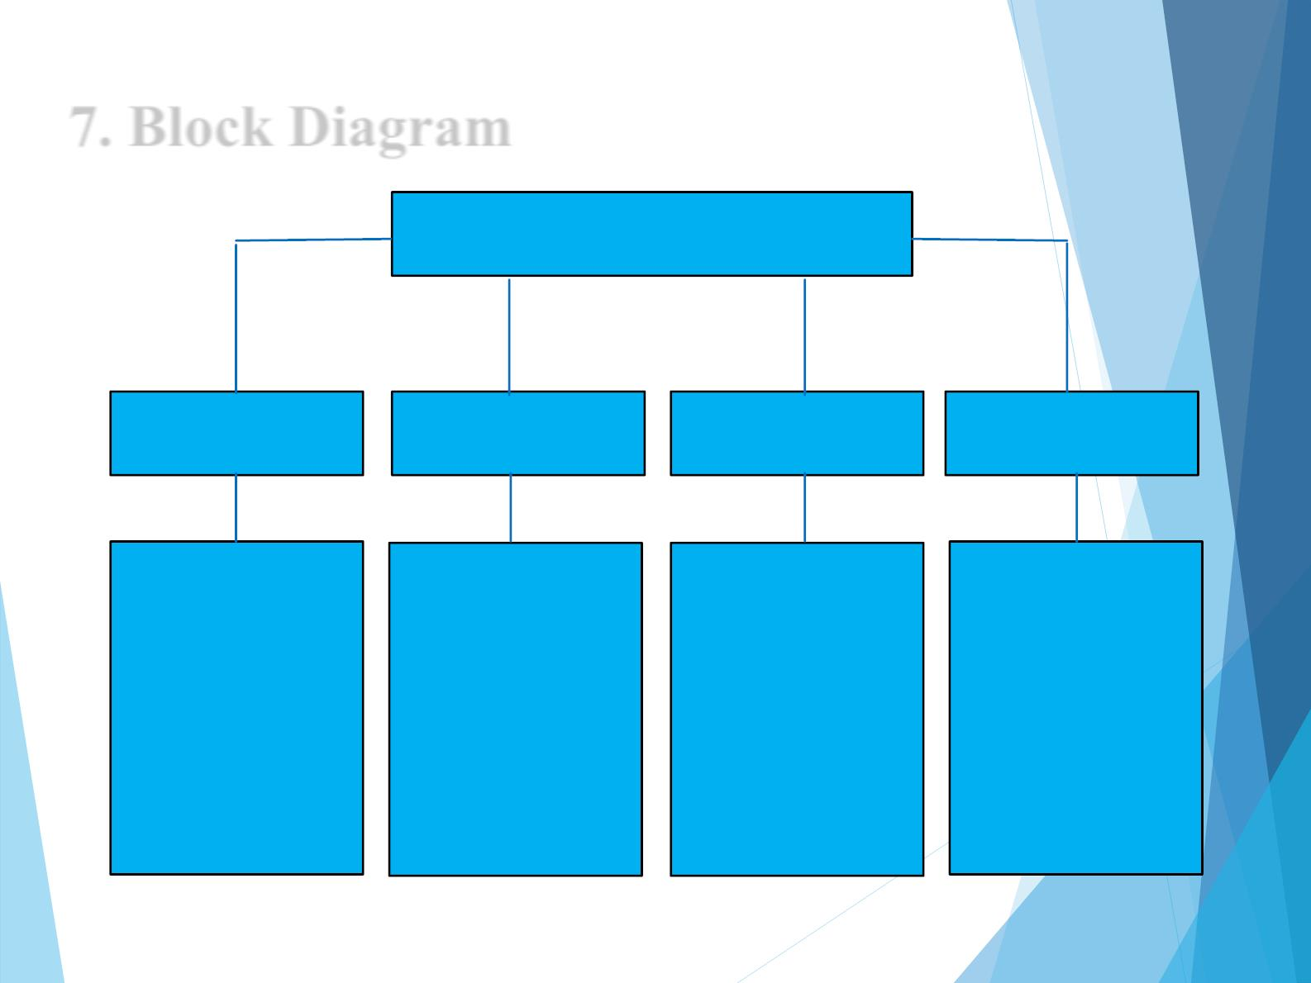
7. Block Diagram
Parking Lot Management System
Home Section
Add Vehicle Section
Manage Vehicle Section
History Section
To add vehicles like 2-
wheeler, 4-wheeler along
with customer & vehicles
details.
To keep records of the
vehicles and slots allotted
in a tabular form.
To check the History of
vehicles parked and
unparked.
To see the parked vehicles
and free slots for parking.

Slide 11
Thank You...!!

